Slide 1
Ever Hardware Industrial Limited
Make The World A Better Place

Slide 2
FASTENERS INTEGRATOR
Ever Hardware provides companies with the fasteners, tools, and supplies they need to manufacture products, build structures, protect personnel, and maintain facilities and equipment.
Guided by a motto of "Make The World A Better Place," our local teams work closely with customers to keep needed supplies flowing, provide supply chain solutions and expertise, and drive business improvements that help them compete and thrive. Simply put, we don't just make a sale — we align with our customers to make them more successful.

Slide 3
1
2
3
4
WHO WE ARE
WHAT WE DO
OUR SKILLS
OUR PRODUCTS
Ever Hardware shows you how to plan, design, and implement, and measure high-quality professional hardware so you and your team can achieve success with your system, your products, and your enterprise.
We are the most professional company devoted exclusively to those who work in hardware development. We help our client's leverage the power of design of hardware to affect positive and lasting change.
We will usually offer a guide or selective email during which you will have the opportunity to discuss your design in detail. We provide a solution for it all.
We keep developing and innovating, offering products and services that help our customers and clients achieve their ambitions. We offer products and services, from cold forming to machining, and stamping to injection molding.
CLICK TO JUMP
CLICK TO JUMP
CLICK TO JUMP
CLICK TO JUMP

Slide 4
1
WHO WE ARE

Slide 5
WHO WE ARE
RESPONSE TIME
CUSTOM SERVICE
SMALL MOQ
We will respond within 12 hours after receiving your order or email.
We offer customized services. Supports most of material, sizes and surface treatments.
Even 10pcs of Electronics or 100pcs of Fasteners are Available.
0086-769-83034515
Info@ever-hardware.com
Ever Hardware Industrial Limited|

Slide 6
WHO WE ARE
RESPONSE TIME
We do provide 24/7 support via Live Chat and mail System.
You can submit an order at any time, however, we advise an email or phone call first to have the opportunity to confirm the details.
Our team offers the ability to respond and manage your email or order in a few hours. In order for us to provide you with fast assistance, please fill in your name and address when sending an email. You can expect a reply within 2 hours.
Usually, our response time is much quicker than this, however, some custom specialty parts may require more time to be processed depending on the case and details.

Slide 7
WHO WE ARE
CUSTOM SERVICE
We have a strict quality control system and can provide more innovative products and services. No matter what kind of material/hardness/surface finish/tolerance. Our company has five years of experience in foreign trade, we can better understand your requirements and provide better flow experience. If you have an express account or not, whether shipping by air or by sea.
We are waiting here, tell us your design or send your drawing/samples..

Slide 8
WHO WE ARE
SMALL MOQ
Ever Hardware offers industry leading MOQs for custom hardware. We’re committed to providing exceptional hardware which meet the high standards of our customers, regardless of quantity.
The manufacturer is always to blame for high Minimum order quantity requirements. Because they must buy materials and parts from subcontractors, on an order to order basis. As well as what kind of machine they have. This in turn requires that the factory can satisfy the MOQ of the subcontractor.
This also explains why different items, and different materials (or even sizes of the same material) has different MOQs.
With some effort, it is possible to work out how the MOQ can be lowered, by identifying which materials and components the supplier keeps in stock, or can buy in lower minimum order volumes. At the same time, we have a lot of machines provide us a large range of production ability.

Slide 9
2
WHAT WE DO

Slide 10
WHAT WE DO
Ever Hardware provides various hardware widely used on sports equipment, electronics, household appliances, motor vehicles etc.
We do have a lot of machines, from cold forming to die casting, from CNC machining to stamping.
0086-769-83034515
Info@ever-hardware.com
Ever Hardware Industrial Limited|

Slide 11
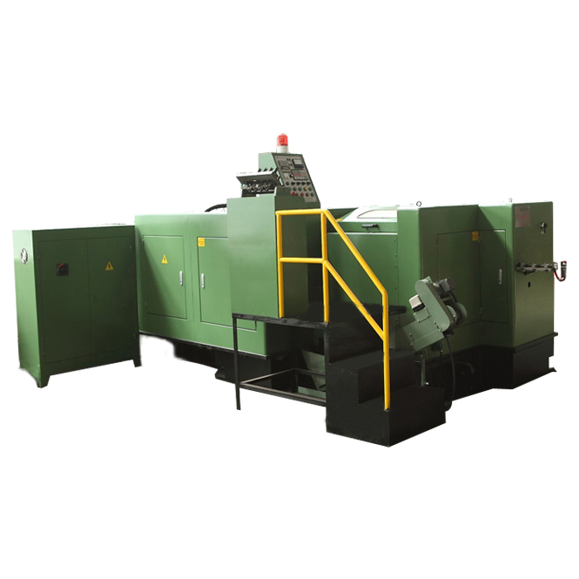
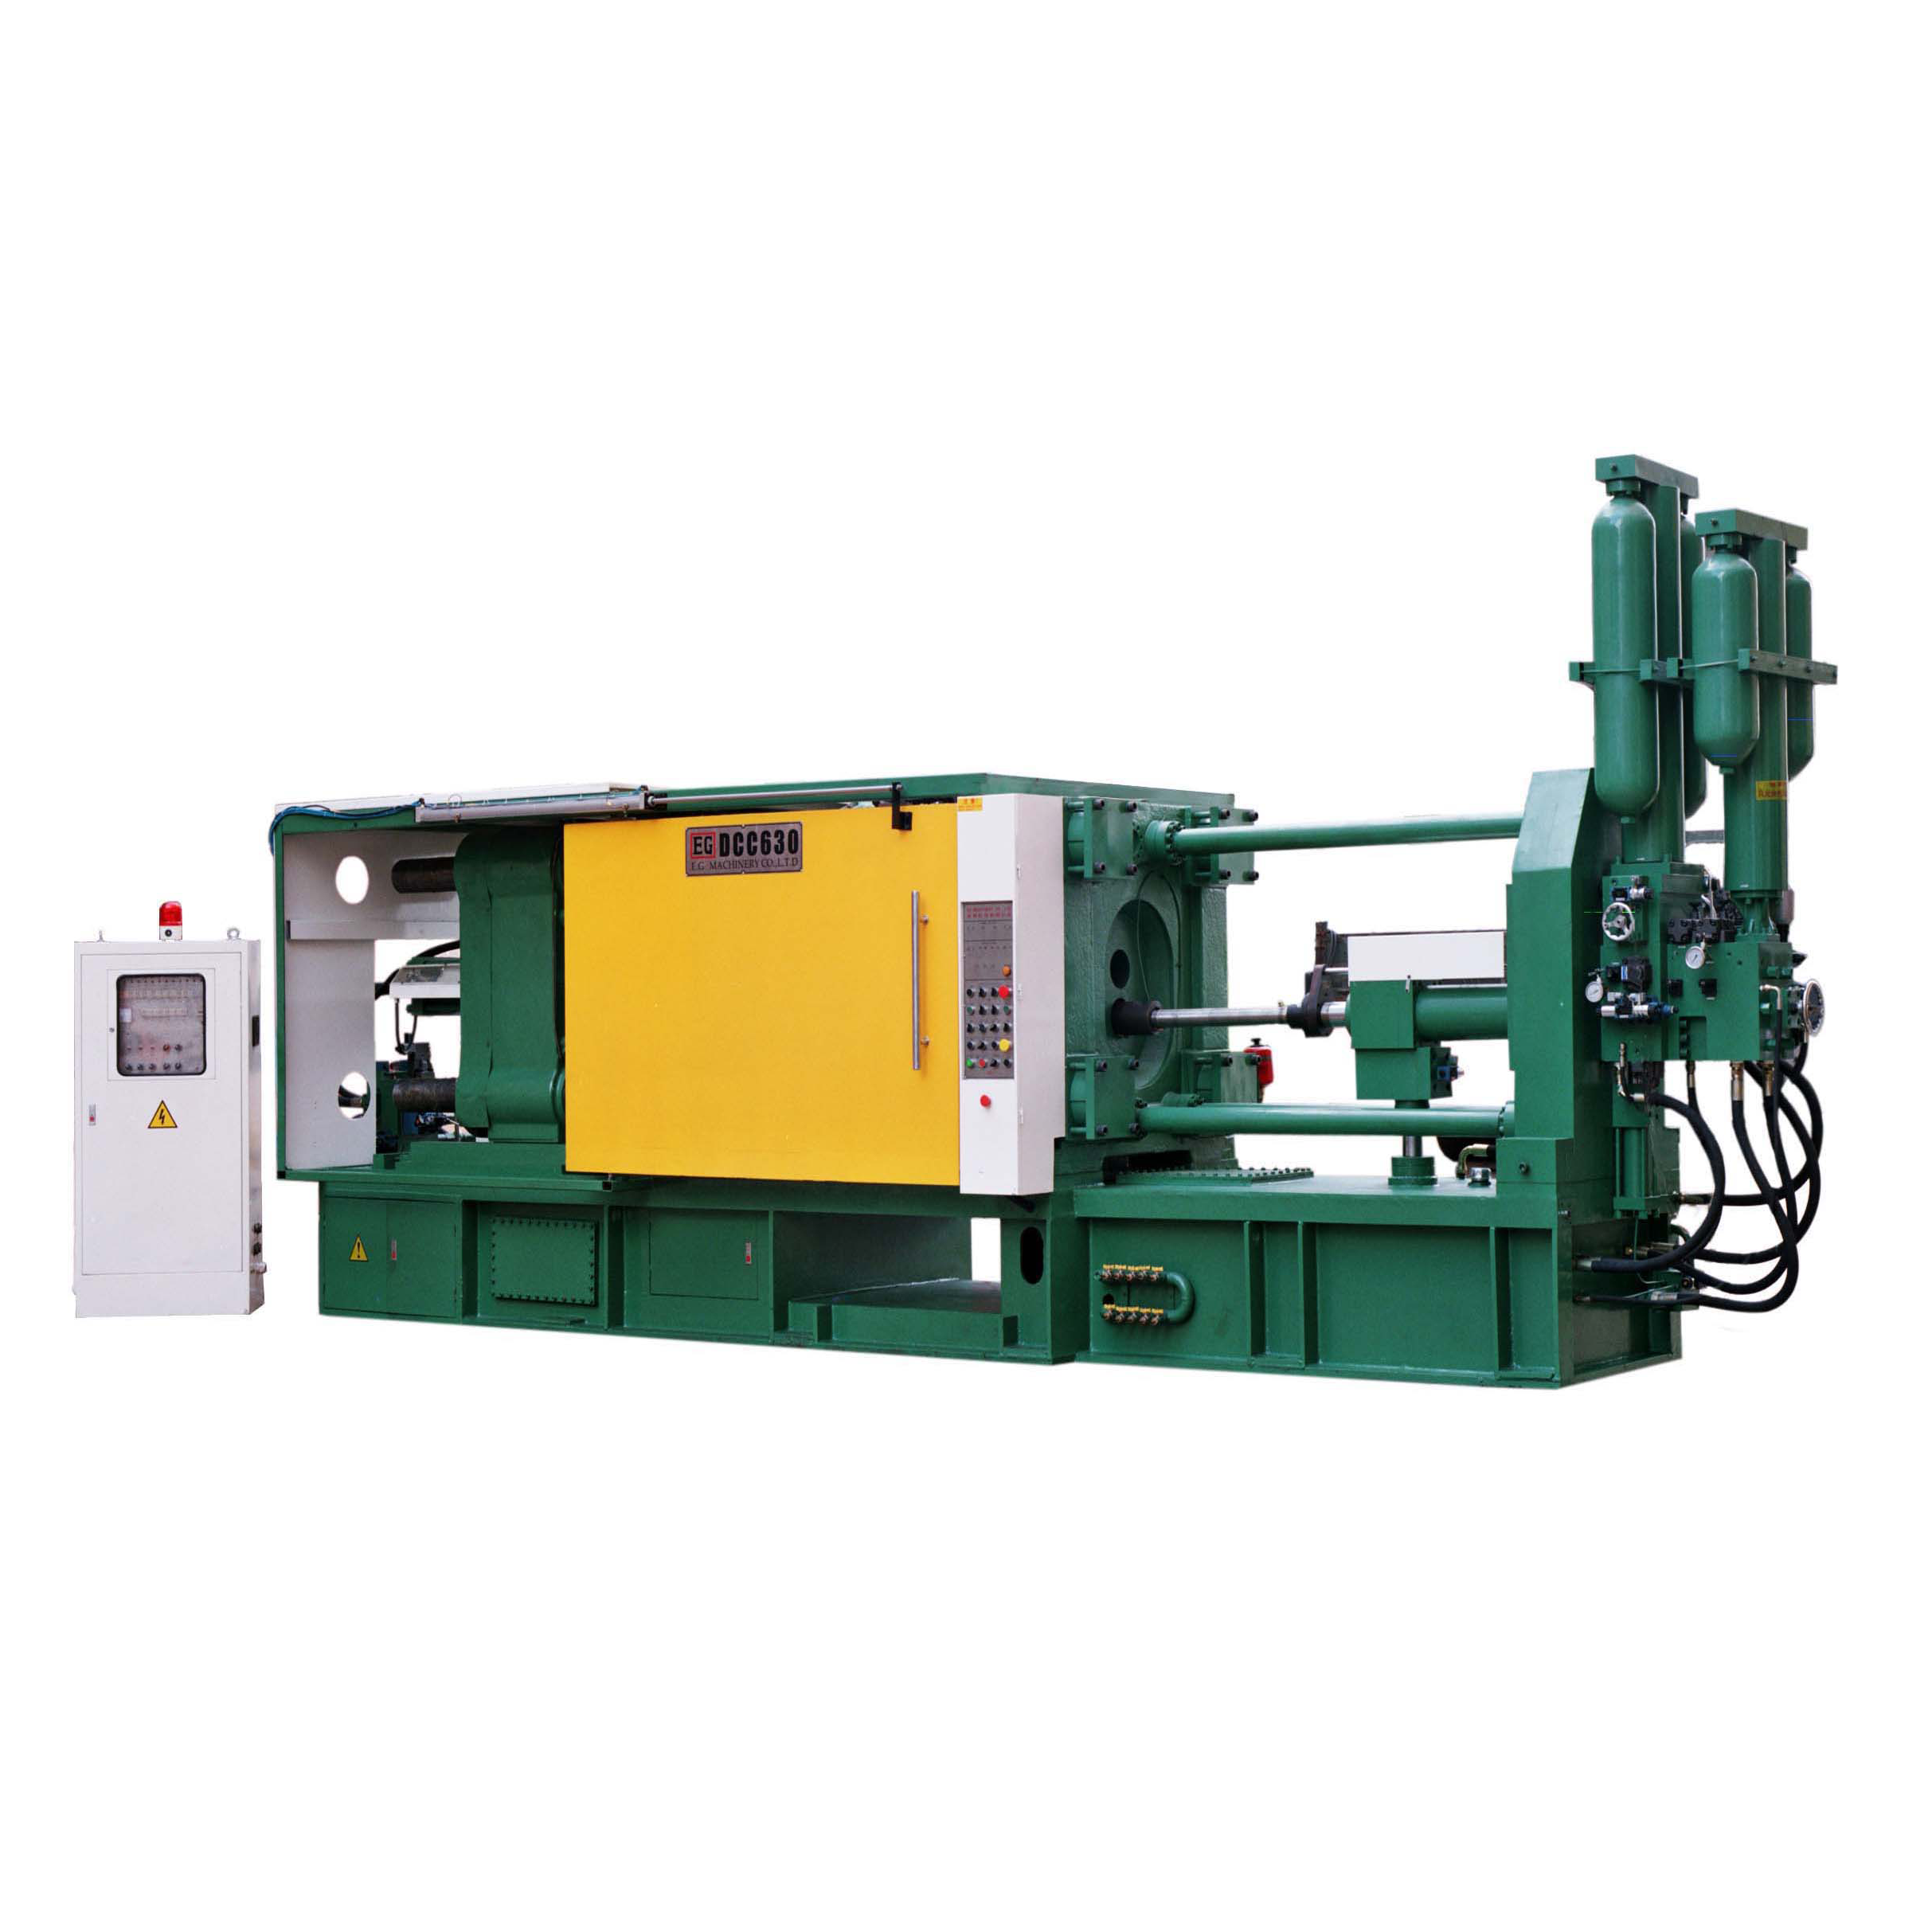
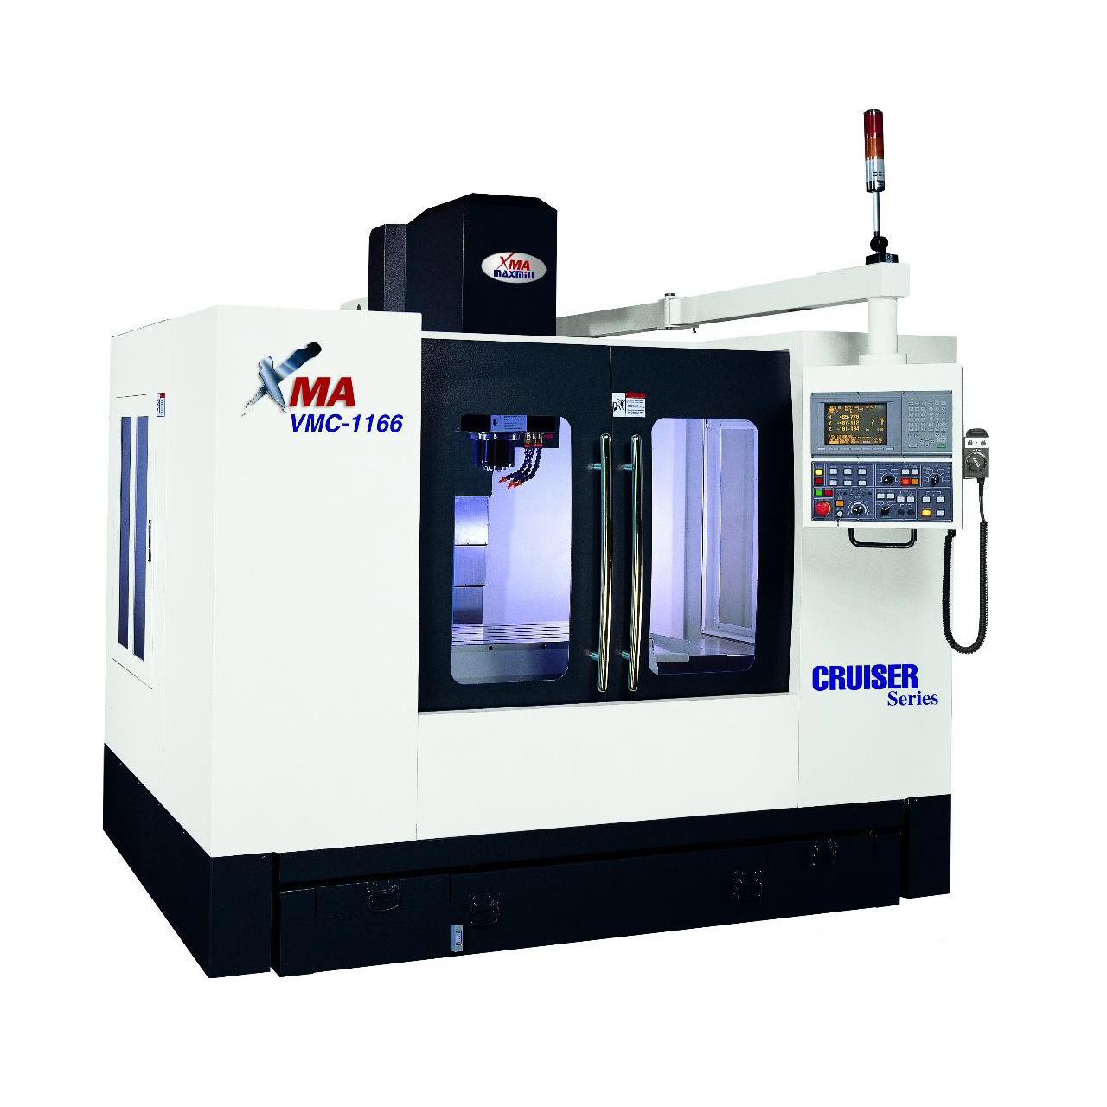
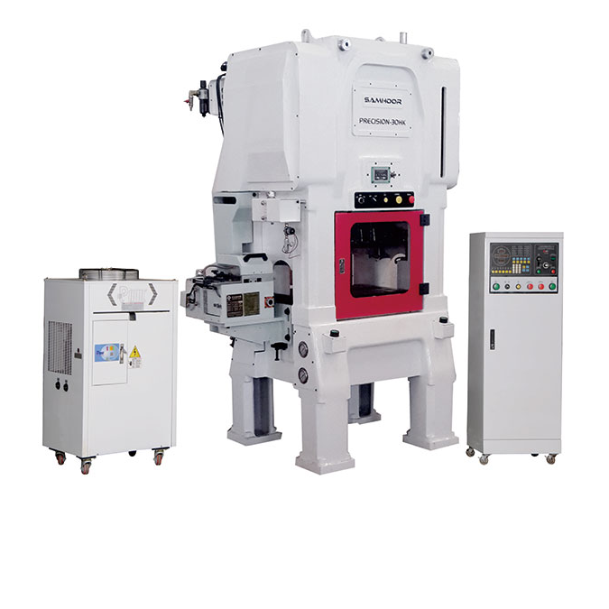
COLD FORMING
DIE-CASTING
MACHINING
STAMPING
37 Sets of Machines
Clamping Pressure 7 to 50 Metric Tons
Mills
Press Rating 30 to 200 tons
0.8mm to 16mm Or #0 to 5/8” Diameter
250 to 700 Shots per Hour
Lathe
Max Press Speed 600 SPM
1,000mm Or 40 Inches Long
Mold Longevity Up to 2,000,000 shots
Cutting
Part Thickness .003 to .188 in
10 Million PCS per Day
Tolerance ± 0.0005 inch Part Specific
Drilling
Tolerance (+/-) Less than .0005 in
0086-769-83034515
Info@ever-hardware.com
Ever Hardware Industrial Limited|

Slide 12
WHAT WE DO
Integration of our own and the surrounding resources, use our design and production advantages to provide you with a variety of standard and non-standard hardware.
Fasteners
Hardware
Electrical
Tools
Our products include bolts, screws, nuts, washers, hex socket products, pins, rivets, bent wire products and specialty items. In addition, all popular sizes of machine, wood and tapping screws are also available for immediate shipment.
We offer a variety of hardware manufactured as per the latest technology to ensure precise quality.
We provide you precisely designed & best-in quality hardware at a reasonable cost according to your request or drawing.
Our R & D department is developing in-vehicle and home electronics. Our own car navigator and smart outlet brands are now available.
We provide a variety of fastener removal tools, such as the drivers and wrenches. At the same time, our tools are widely used in a variety of sports equipment, especially in skateboards.

Slide 13
3
OUR SKILLS

Slide 14
OUR SKILLS
1
STABILITY
2
COST MANAGEMENT
Stability. At a time when many hardware purchasers are concerned about the quality stability of their products, Ever Hardware, is a solid, trusted, accountable partner.
Cost management. Many hardware providers have recognized the wisdom of outsourcing their operational functions. With Ever Hardware, you can be confident that your needs will be met. And you can be sure that we will provide contracted or agreed-upon services at a fair price.
Advanced technology. Ever Hardware has a first-class engineering and R & D team, with state-of-the-art reporting and audit controls.
Innovation. We can help establish a vision of market changes and describe where you can be in this changing environment. We have insights on how to achieve tomorrow’s goals today.
3
ADVANCED TECHNOLOGY
4
INNOVATION
0086-769-83034515
Info@ever-hardware.com
Ever Hardware Industrial Limited|

Slide 15
OUR SKILLS
Accurate system management ensures the accuracy of every step of the way from raw material purchase to delivery.
Creative design. Our engineering and R & D team can help you with any design you want.
Technical maintenance. To ensure that the product meets your assembly requirements, and we provide technical support for the development and design of subsequent versions of your product.
Logistics management, to ensure that you receive your product in time and complete.
Material
Samples
Mass Production
Delivery
Testing
Testing
Testing
0086-769-83034515
Info@ever-hardware.com
Ever Hardware Industrial Limited |

Slide 16
4
OUR PRODUCTS

Slide 17
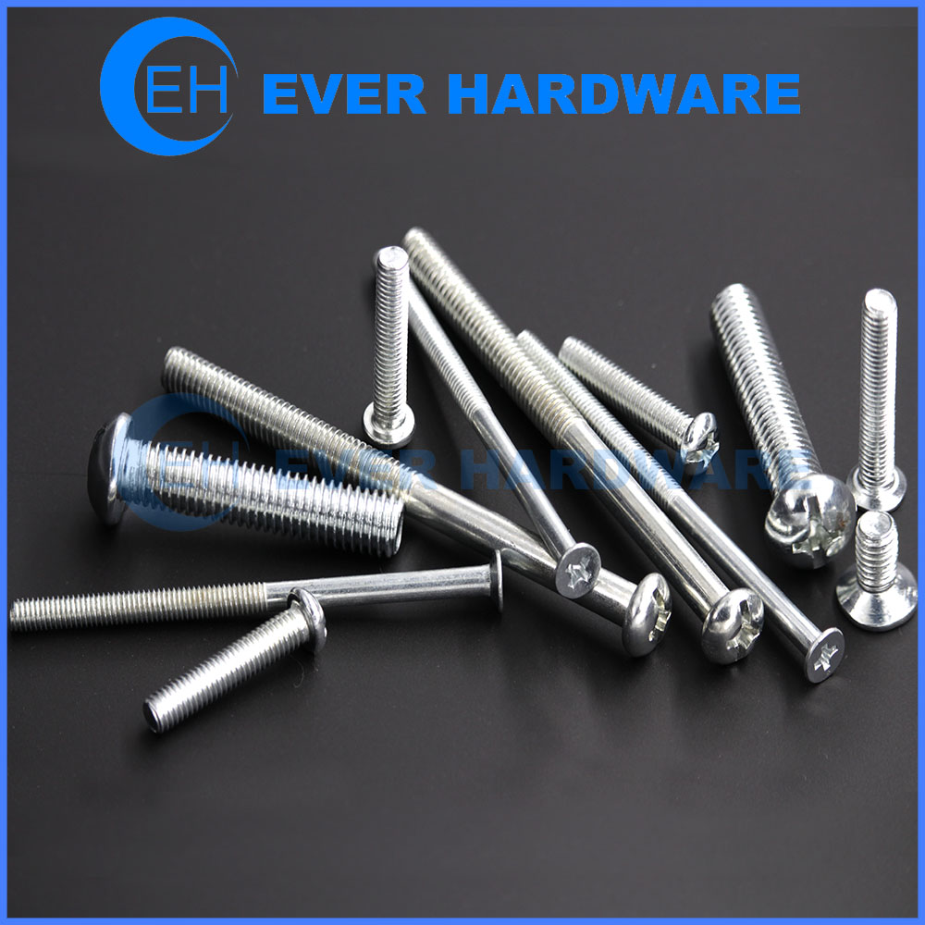
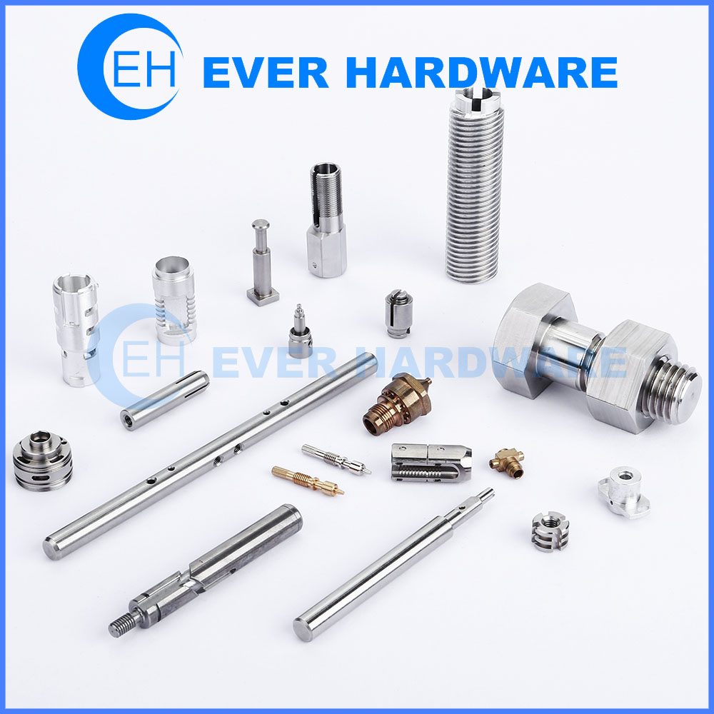
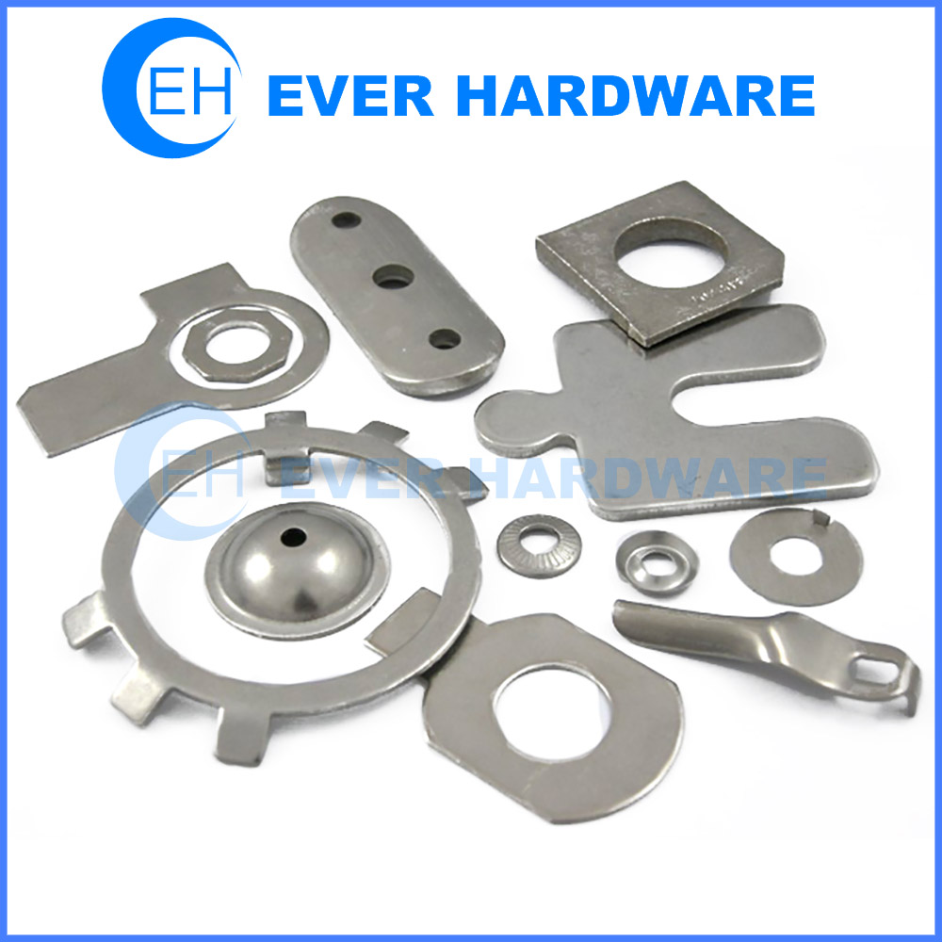
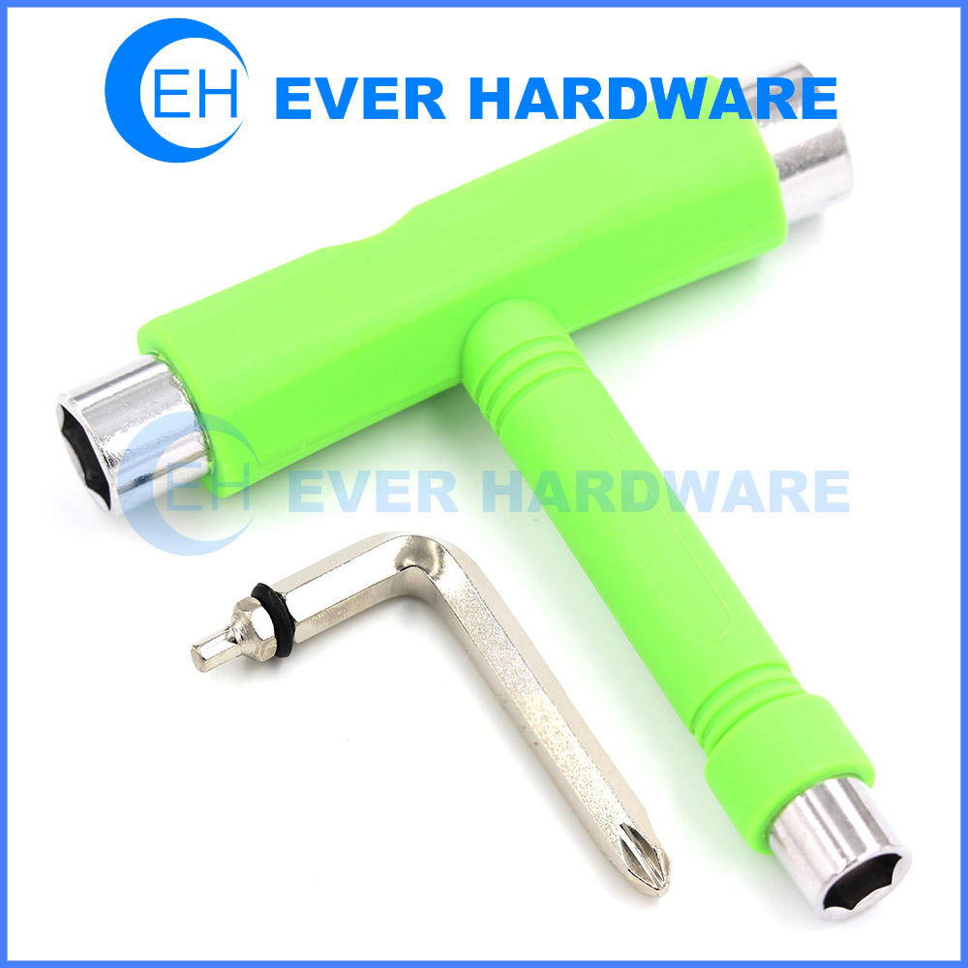
OUR PRODUCTS
COLD FORMING FASTENERS
Standard & Customized
MACHINING COMPONENTS
According to Request or Drawing
STAMPING PARTS
Custom Made & Standard Tools
0086-769-83034515
Info@ever-hardware.com
Ever Hardware Industrial Limited|

Slide 18
OUR PRODUCTS
34%
From 2014
2,300
Million Pieces
We have sold a total of 2.3 billion products since our company was founded in 2001. Customer satisfaction is over 98%. Our story is still going on.
0086-769-83034515
Info@ever-hardware.com
Ever Hardware Industrial Limited |

Slide 19
OUR PRODUCTS
ALL OVER THE WORLD
First Pass Yield (FPY)
Our products have been sold to more than 50 countries and regions in the world. Especially in Europe and the United States are welcomed. Many of them are big international trading companies like Fastenal, Bossard and Pencomm.
93%
From 2015
0086-769-83034515
Info@ever-hardware.com
Ever Hardware Industrial Limited |

Slide 20
43.7%
43.3%
More than 300 clients in our most important market area.
Our products are sold in most European countries and the feedback is very good.
1
2
3
4
8.4%
4.6%
We are working hard to provide more and more emerging countries with hardware solutions.
We are delighted to find that the African market is getting more and more important.
0086-769-83034515
Info@ever-hardware.com
Ever Hardware Industrial Limited |

Slide 21
THANK YOU !
PRESENTED BY Ever Hardware Industrial Limited

